Slide 1

Dashboard Overview: Performance, Cost, and CST Analysis
Team – 4

Slide 2
Dashboard's purpose.
Evaluate Business Performance: Track key performance indicators (KPIs) such as total products sold, revenue generated, and net profit, allowing stakeholders to gauge overall business health.
Analyze Revenue and Profit Trends: Visualize revenue and profit by location and product type to identify high-performing areas and products, enabling targeted strategies for growth.
Examine Cost Structures: Analyze manufacturing and shipping costs, as well as average lead times, to identify areas for operational efficiency and cost reduction.
Understand Customer Segmentation: Explore sales and profit metrics segmented by customer demographics to tailor marketing and sales strategies, enhancing customer engagement and satisfaction.

Slide 3
1- KPI (Key Performance Indicators)
Purpose: To provide a quick snapshot of overall business performance.
Key Metrics:
Highlight key performance indicators:
Total Products Sold: 46k
Revenue Generated: $577.60k
Net Profit: $524.68k
Products: 100
Suppliers: 6
Transportation Modes: 5
Average Defect Rate: 2.28%

Slide 4
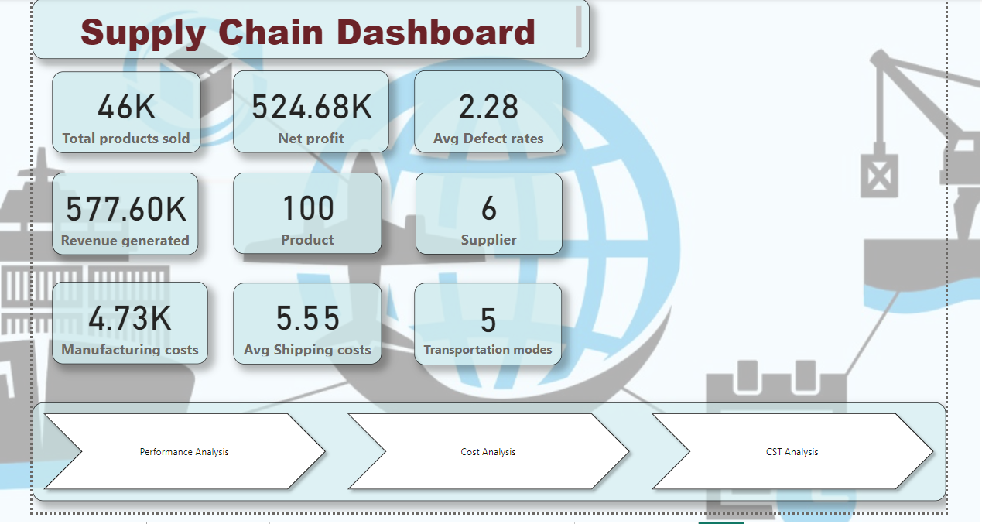

Slide 5
2 - Performance Analysis
Purpose: To evaluate sales performance across different dimensions.
Key Insights:
Revenue Generated by Location: Identifies geographical strengths.
Profit by Location: Highlights areas of profitability.
Revenue by Product Type: Assesses product category performance.
Profit by Product Type: Evaluates which products contribute most to profit.
Profit margin by Product Type: Evaluates which products contribute most to margins

Slide 6
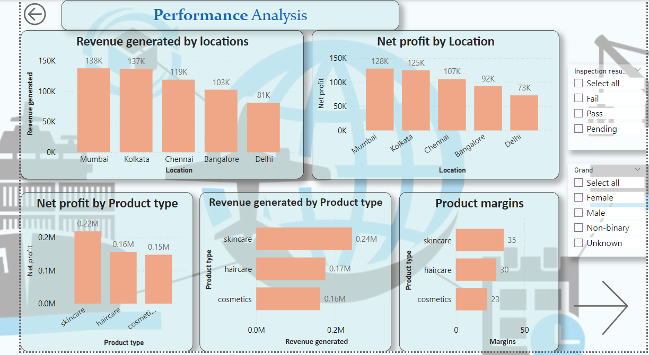

Slide 7
3 - Cost Analysis
Purpose: To understand and manage cost structures effectively.
Key Insights:
Manufacturing Cost: Analyzes production expenses.
Shipping Cost: Assesses logistics costs.
Cost Comparison by Route and Product Type: Identifies cost efficiencies.
Average Lead Time: Evaluates supply chain efficiency.

Slide 8
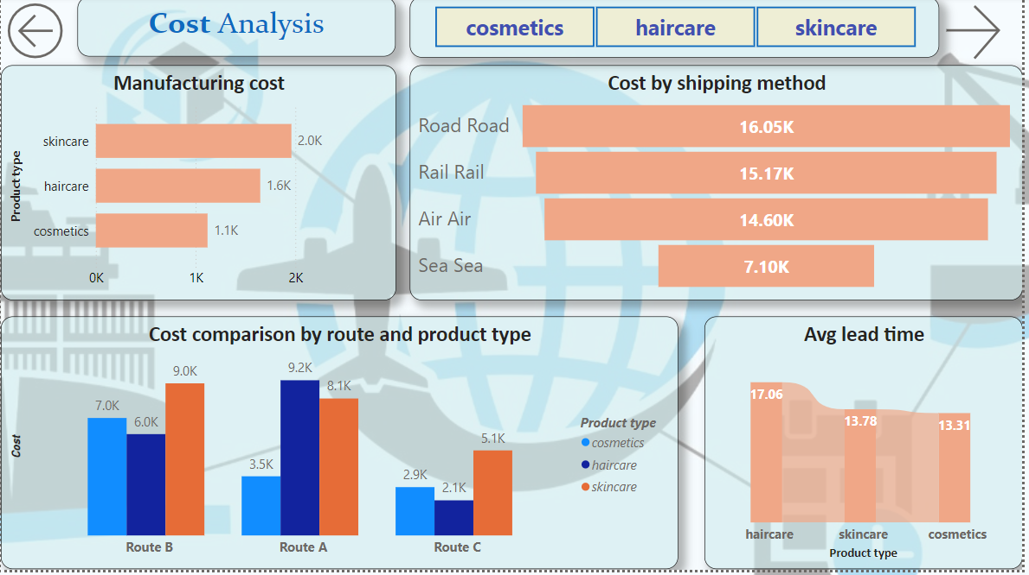

Slide 9
4 - CST (Customer Segmentation and Targeting) Analysis
Purpose: To analyze customer demographics and behaviors for targeted strategies.
Key Insights:
Sales by CST Demographics: Reveals customer preferences.
Profit by CST Demographics: Assesses profitability across customer segments.
Type of Product Sold by CST Demographics: Highlights product popularity among demographics.
CST by Location: Identifies geographical distribution of customer segments.

Slide 10
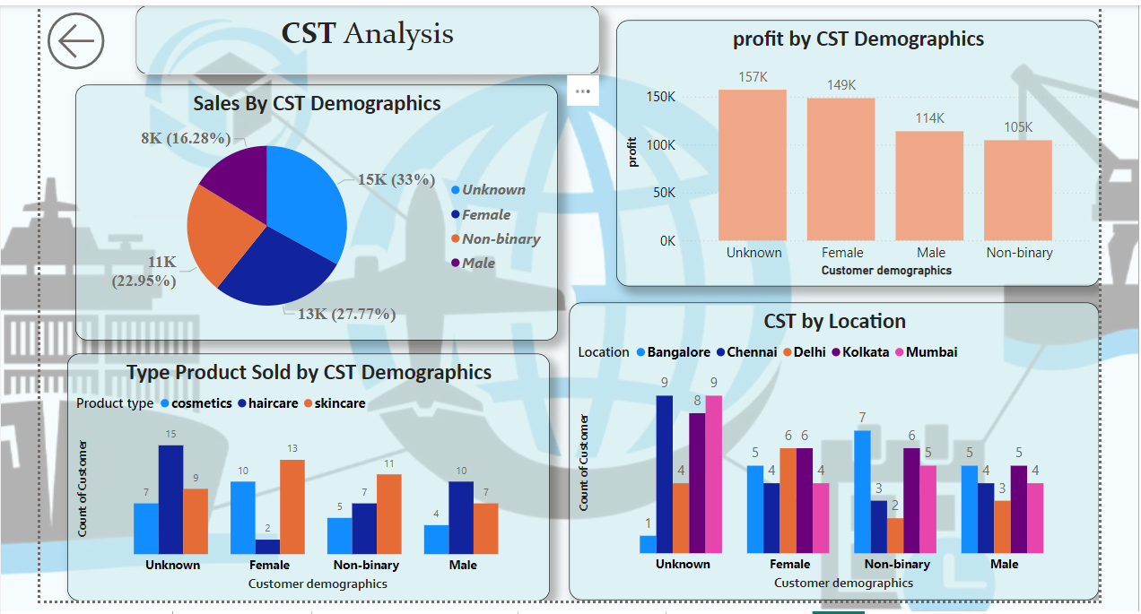

Slide 11
Notable Findings
Market Opportunities: There may be untapped market segments or product types that could be explored, especially if current sales trends show strong performance in certain demographics.
Logistics Optimization: Analyzing shipping costs relative to revenue could lead to better logistics strategies, potentially increasing profit margins.
Product Focus: Concentrating on high-margin products can lead to enhanced profitability, suggesting that efforts should be made to promote these items further.

Slide 12
Key Insights from the Dashboard
Strong Overall Performance
The total products sold (46k) and revenue generated ($577.60k) indicate robust sales activity. The net profit of $524.68k suggests effective cost management and a profitable operational model.
Geographical Insights
Revenue and profit by location data can reveal high-performing regions. If certain locations consistently outperform others, targeted marketing and resource allocation can enhance performance in lower-performing areas.

Slide 13
Product Performance
The analysis of revenue and profit by product type provides insights into which products are driving sales. Identifying top-performing products allows for focused marketing strategies and potential expansion of successful lines.
Cost Management
The cost analysis highlights critical areas for operational efficiency. For instance, comparing manufacturing and shipping costs can help pinpoint areas for cost reduction. If shipping costs are disproportionately high compared to profits, it may indicate a need to optimize logistics.
Customer Segmentation Insights
The CST analysis reveals significant trends in customer demographics. Understanding which demographics generate the most sales and profit can inform targeted marketing campaigns and product development.

